Slide 1
Bus reservation system
Team Members:
Guhan – 2022506065
Vishnu Bharathi- 2022506309
Manoj Christopher Raj S - 2022506038

Slide 2
Agenda
General Overview
System Implementation
Challenges Faced

Slide 3
General overview
The bus reservation system allows users to book, cancel, and manage bus tickets.
Features:
User authentication (Admin and Standard User)
Booking and cancellation of tickets
Viewing bus and seat details
Stakeholders:
Administrators
Standard Users

Slide 4
Key Classes and Their Functions
Class ID
Contains two member :user_name and password.
Functions:
get_username()
get_password()
Class reserve:
Contains data members:
Busn, driver,arrival,depart,from,To,seat,user_id,cost
Functions:
Display()
Disp_seat()
Check_empticket()
Check_empty()

Slide 5
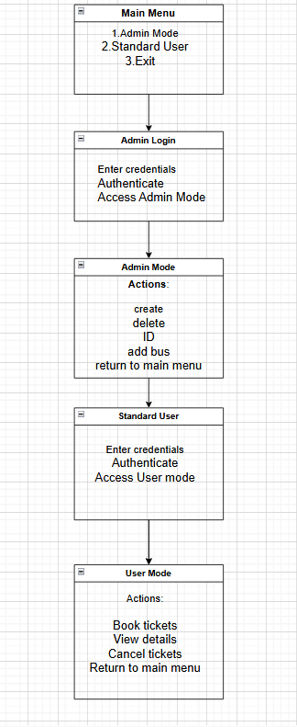
Main menu Navigation flowchart

Slide 6

Challenges faced

Slide 7
Technical challenges
Integrating the code and Debugging it.
Managing concurrent data access
Implementing user friendly console interface.
Ensuring multiple users can book ticket and cancel without inconsistencies.

Slide 8
Logical challenges
Implementing logic to accurately allocate seats and prevent double bookings.
Validating user inputs and handling errors.
Keepingg track of current state of bookings and ensuring consistency between booking,cancelling,viewing reservations.

Slide 9

Potential Improvements
Graphical user interface (GUI) enhancement
Database Integration
Real time Seat Availability
User feedback Mechanism.

Slide 10
THANK YOU

